Slide 1

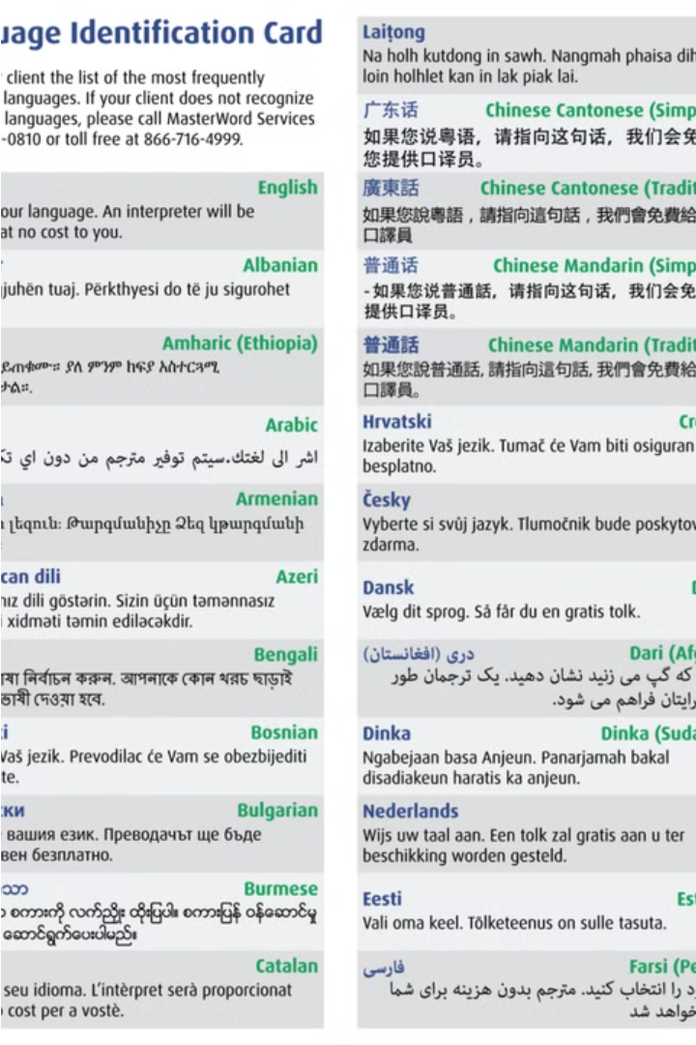


Introduction to Language Identification
Language identification is the task of automatically determining the language of a given text. This is a fundamental challenge in natural language processing, with applications in information retrieval, machine translation, and multilingual content analysis.
by Baranitharan S

Slide 2
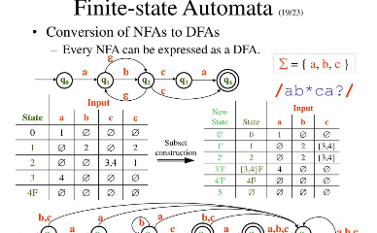
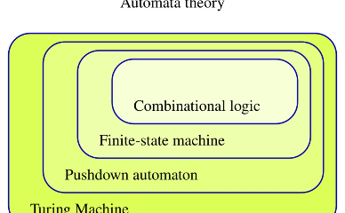
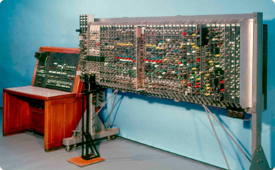
Formal Languages and Automata Theory
Finite State Automata
Pushdown Automata
Turing Machines
Finite state automata are mathematical models that recognize regular languages through a finite number of states and transitions. They form the foundation of computer science and are used in various applications, from text editors to compilers.
Pushdown automata are more powerful than finite state automata, as they can recognize context-free languages by using a stack data structure. They are crucial in understanding the theoretical limits of computability and the complexity of programming languages.
Turing machines are the most general computational model, capable of recognizing any computable language. They serve as the theoretical foundation for modern computers and are essential in understanding the fundamental limits of computation.

Slide 3



Regular languages and finite state automata
Strings
1
Sequences of symbols
Regular expressions
2
Patterns for defining languages
Finite state automata
3
Machines that recognize regular languages
Regular languages are a fundamental class of formal languages that can be recognized by finite state automata (FSAs). FSAs are simple computational models that process input strings one symbol at a time, transitioning between different internal states. Regular expressions provide a concise way to define regular languages, making them a powerful tool for tasks like text processing and pattern matching.

Slide 4
Context-free languages and pushdown automata
Formal definitions
1
Context-free grammars and context-free languages are defined using production rules and derivation trees.
Pushdown automata
2
Pushdown automata are a type of finite state machine with a stack, able to recognize context-free languages.
Equivalence
Context-free languages and pushdown automata are equivalent in their expressive power - they can recognize the same set of languages.
3
Context-free languages are a important class of formal languages that go beyond regular languages in their expressiveness. They can be recognized by pushdown automata, a computational model that augments finite state machines with a stack data structure. The equivalence between context-free grammars and pushdown automata is a fundamental result in the theory of computation.

Slide 5




Turing Machines and Computability
Universal Machines
Computability Theory
Problem Solving
Turing machines are universal computational devices that can simulate any algorithm or computer program given an appropriate description.
Turing machines provide a formal model for studying the limits of what can be computed. They form the foundation of computability theory.
Turing machines can be used to solve a wide range of computational problems, from simple arithmetic to complex decision problems.

Slide 6
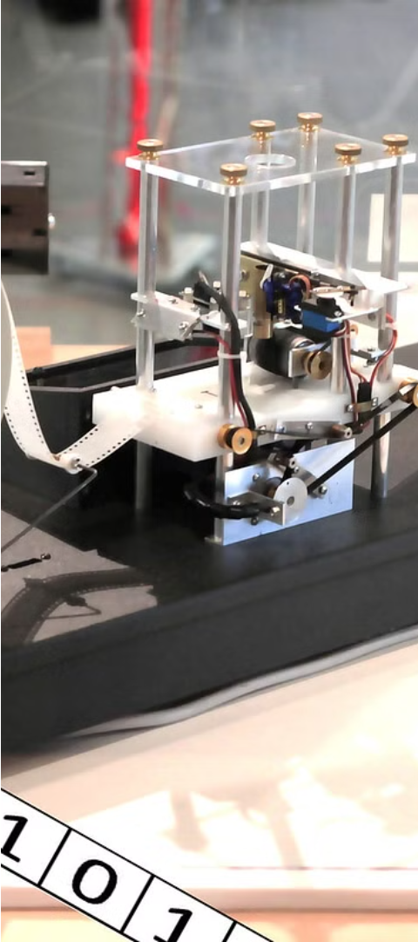
Decidability and Undecidability
1
Decidable Problems
Problems for which there exists an algorithm that can determine the answer in a finite amount of time are considered decidable. These can be solved by Turing machines or other computational models.
2
Undecidable Problems
Problems that have no effective computational procedure to solve them in a finite number of steps are undecidable. The classic example is the Halting Problem for Turing machines.
3
Limits of Computation
Undecidable problems demonstrate the fundamental limits of what can be computed, even with unbounded time and memory. This has deep implications for the theory of computation.

Slide 7
Complexity theory and language identification
P vs NP
1
The fundamental question of whether efficient algorithms exist for NP-complete problems
Computability theory
2
Exploring the limits of what can be computed by Turing machines
Inductive inference
3
Algorithms for learning and identifying languages from sample inputs
The field of language identification sits at the intersection of complexity theory and computability theory. Understanding the theoretical limits and capabilities of algorithms for language learning is crucial for developing efficient and robust language processing systems. This section will delve into the key concepts, challenges, and advancements in this interdisciplinary domain.

Slide 8
Applications of Language Identification
Machine Translation
Content Moderation
Information Retrieval
Sentiment Analysis
Language identification is crucial for accurate machine translation, allowing systems to detect the source language and apply the appropriate translation models.
Identifying the language of user-generated content helps moderators enforce policies and guidelines across multilingual platforms.
Language detection enables search engines to return relevant results by understanding the query language and matching it to indexed content.
Accurate language identification is a prerequisite for sentiment analysis, which relies on understanding the nuances of language to gauge the emotional context of text.

Slide 9



Challenges and Limitations
Complexity
Linguistic Diversity
Ambiguity
Language identification can be computationally complex, especially for more advanced language models and grammars.
The vast diversity of natural languages, dialects, and idiomatic expressions poses significant challenges for accurate identification.
Certain language constructs can be ambiguous, making it difficult to definitively classify them into a specific language.

Slide 10

Conclusion and Future Directions
In this presentation, we have explored the fundamentals of language identification within the theory of computation. As we look towards the future, there are exciting advancements on the horizon that hold great promise for this field.

